Slide 1

Cosy Cafeteria
Robin Van de Poel, Arthur Van den Storme, Tobias Cromheecke, Thomas Feys

Slide 2
Goals
Monitor the availability of the seats in the cafeteria
Monitor the queue in the cafeteria
Extra’s: air quality, temperature and sound level
Display the data to the students with a dashboard on a website

Slide 3
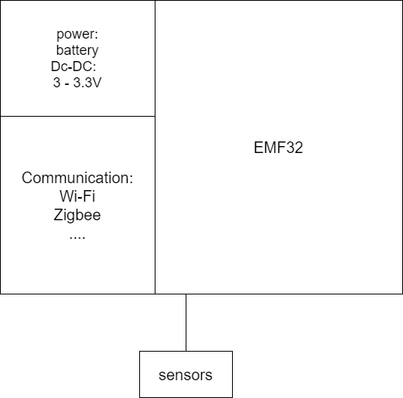
Architecture:
Sensors: IR grid sensor, temperature and air quality sensor and microphone
Power: lithium cell, rechargeable, DC-DC converter
CPU: EMF32
Communication: undecided: Wi-Fi or Zigbee

